Slide 1



MILESTONE 4
INVENTRA-INTELLIGENT
INVENTORY MANAGEMENT SYSTEM
Presented by : TEAM 1
Rishwana Sirajutheen
Naga Syamala Chintapalli
Dritisai Sivarathri
Tanoor Kiran
Hemanth Ravva

Slide 2

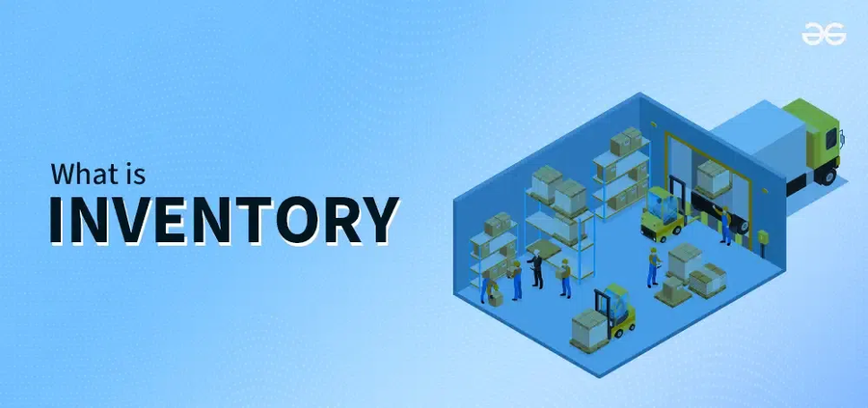
INTRODUCTION
Inventra is a web-based Inventory Management System
It helps to track items, stock levels and transactions
Solves problems like manual records, missing stock info
Provides easy monitoring + role-based access

Slide 3


To understand how an inventory system works digitally
To automate stock handling and transaction tracking
To learn secure login + role-based control
To improve inventory accuracy and reduce time
OBJECTIVE

Slide 4

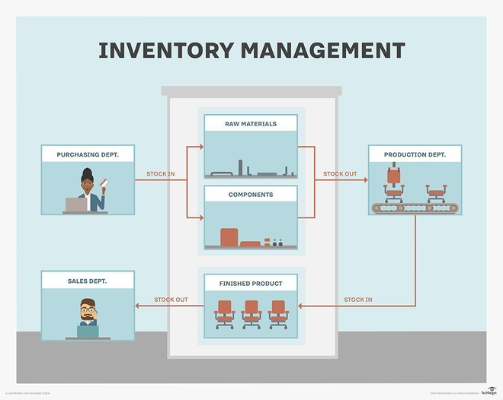
PROBLEM STATEMENT
Manual stock handling causes errors and confusion
Difficult to know real-time available stock
No clear tracking of who added/issued items
Reports and history are not maintained properly

Slide 5

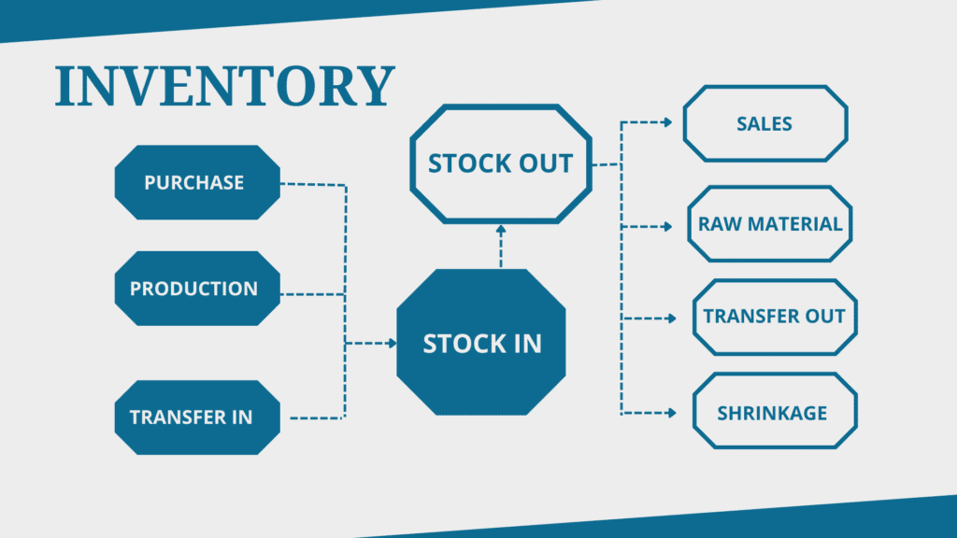
SYSTEM OVERVIEW
Users login using Authentication module
Role-based access controls system operations
Inventory modules manage:
Add / Update / Delete stock
Stock availability check
Transactions track in/out movement
Dashboard gives overall view of inventory

Slide 6
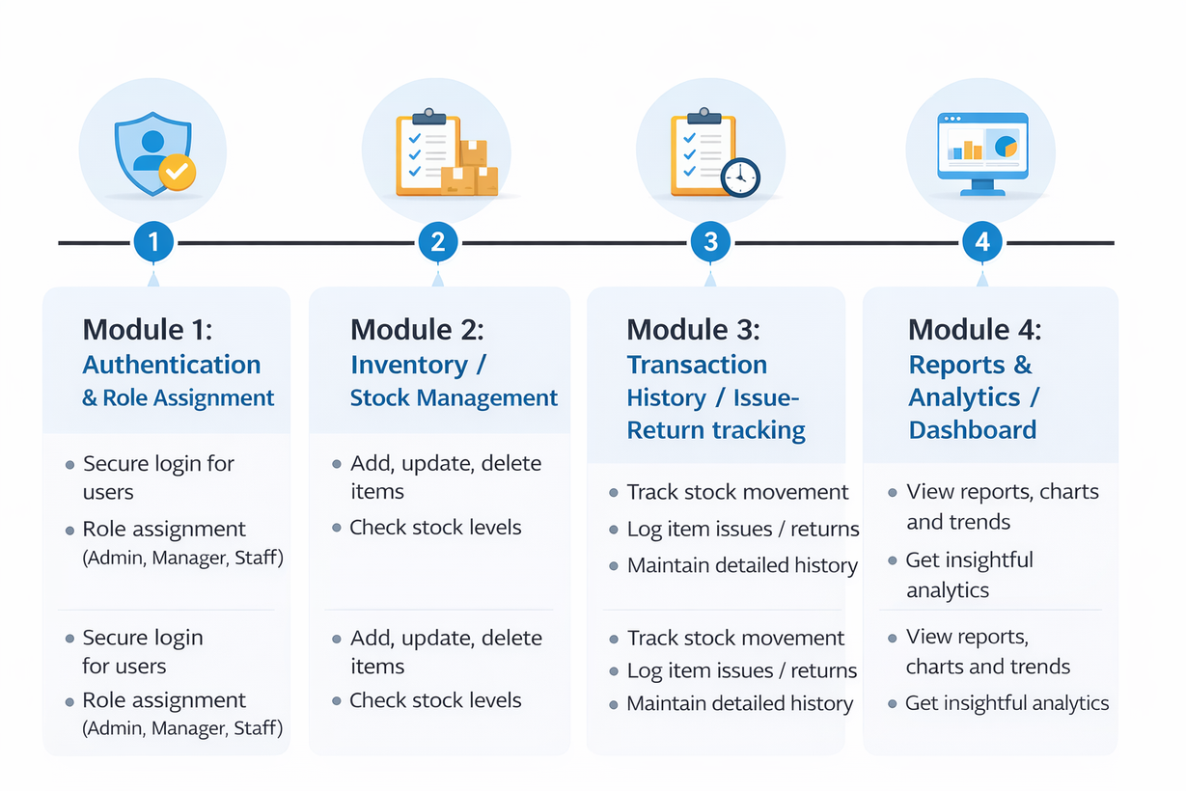
KEY MODULES IN INVENTRA
1
Module 1: Authentication & Role Assignment
2
Module 2: Inventory / Stock Management
3
Module 3: Transaction History / Issue-Return tracking
4
Module 4: Reports & Analytics

Slide 7

MODULE 1: AUTHENTICATION
Entry point of the Inventory Management System
Verifies user identity using username and password
Allows only authorized users to access the system
Provides role-based access (Admin, Manager, Staff)
Restricts users to permitted features only
Username and password are received
Credentials are validated
If valid → token generated
If invalid → error message

Slide 8
•AuthController - Handles HTTP requests
•AuthService - Business logic for authentication
•User Entity - User data model
•UserRepository - Database operations
•JWTUtility - Token generation and validation
•EmailService - Password reset emails
MODULE 1 – KEY CLASSES

Slide 9
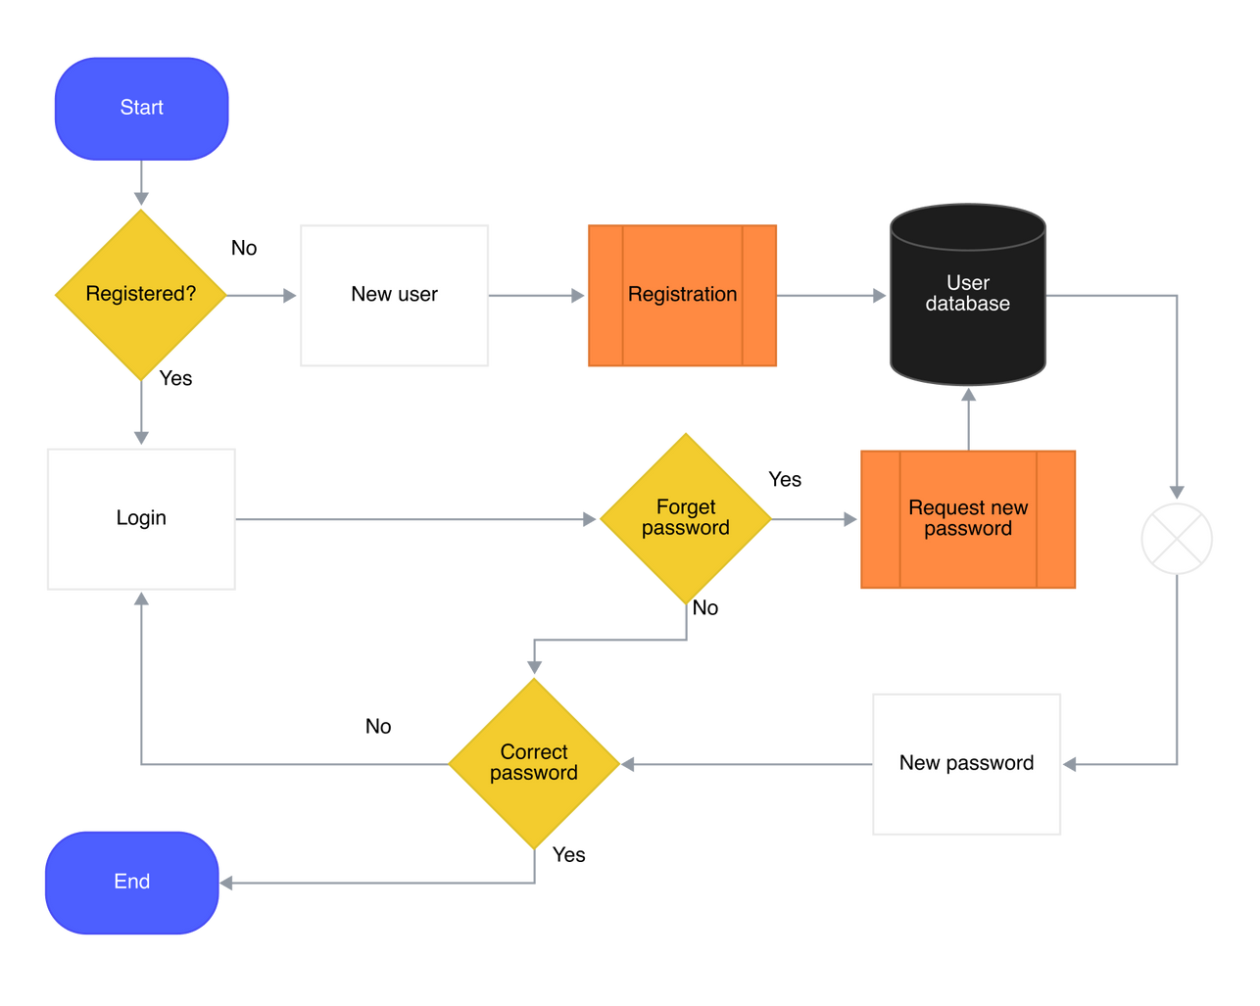

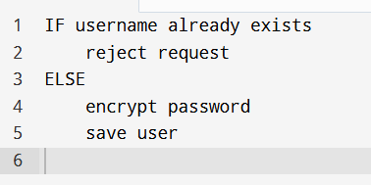
SIGN-UP (REGISTER USER) – LOGIC
Purpose
Create new user securely
Prevent duplicate users
SIGN-UP FLOW
Key Explanation
Username uniqueness enforced
Password encryption before storage
Pseudocode
UI → Controller → Service → Repository → DB

Slide 10
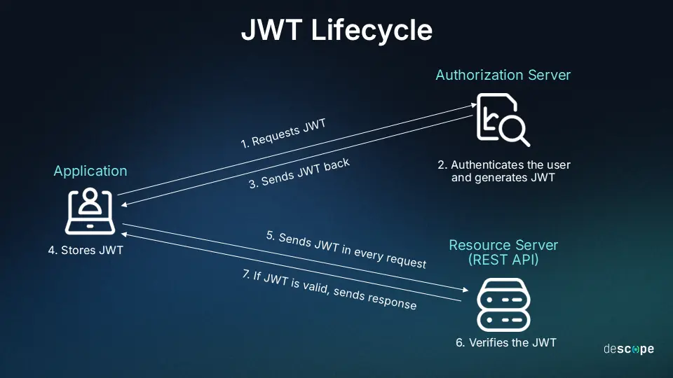
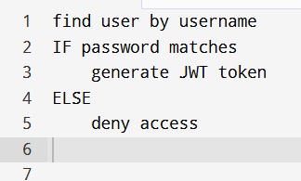
SIGN-IN (LOGIN) & AUTHENTICATION
JWT TOKEN – CORE SECURITY CONCEPT
Purpose
Validate credentials
Generate access token
Pseudocode
Why JWT?
Stateless authentication
Scalable
Secure API access

Slide 11
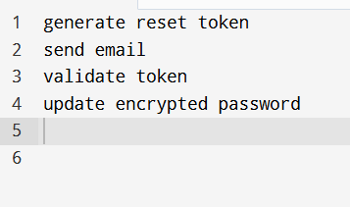
FORGOT & RESET PASSWORD (SECURITY)
MODULE 1 – SUMMARY & STRENGTHS
Purpose
Recover access safely
Avoid password exposure
Key Strengths
Secure authentication
Encrypted password storage
Token-based authorization
Industry-standard architecture
FLOW
Pseudocode
User Interface (UI)
↓
AuthController
↓
AuthService
↓
UserRepository
↓
Database
↑
JWT Token Generated
↑
Response sent to UI

Slide 12
MODULE 2: PRODUCT / INVENTORY MANAGEMENT
Module 2 is the core operational module of the Inventra – Intelligent Inventory Management System.
It is responsible for managing products and maintaining accurate stock levels in real time.
🔹 Purpose of Module 2
The main goal of this module is to:
Store product details in a structured manner
Track stock availability continuously
Handle real-world inventory operations like stock-in and stock-out
Prevent stock mismatch and negative inventory

Slide 13
Product Entity - Product data model with SKU, quantity, price
ProductController - REST endpoints for product operations
ProductService - Business logic for inventory management
ProductRepository - Database queries
TransactionService - Logs stock movements
MODULE 2 – KEY CLASSES

Slide 14
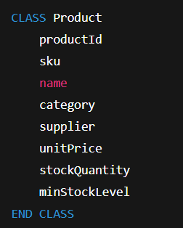
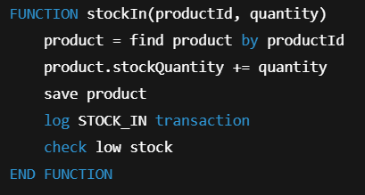
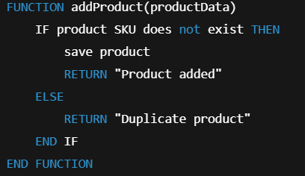
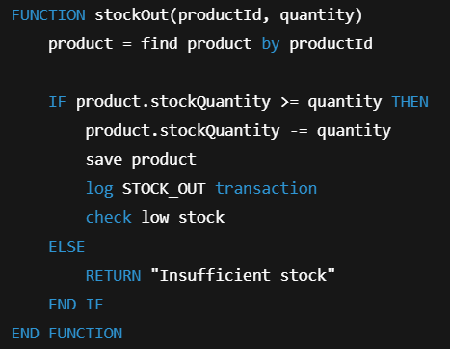
PSEUDOCODE
🔹 Product Entity
🔹 Stock In
🔹 Add Product
🔹 Stock Out

Slide 15
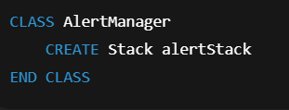
MODULE 3: INVENTORY ALERTS MODULE
Module 3 is the Inventory Alerts Module, which adds intelligence and automation to the Inventra – Intelligent Inventory Management System.
Its primary role is to monitor stock levels continuously and notify responsible users before a stock-out situation occurs.
ALERT TRIGGER FLOW
Stock Update → Check Minimum Level → Alert Triggered
PSEUDOCODE
🔹 Purpose of Module 3
The main objectives of this module are to:
Detect low-stock conditions in real time
Notify users at the right time
Avoid repeated or unnecessary alerts
Improve inventory decision-making
🔹 Alert Logic Using Stack

Slide 16
MODULE 3 – KEY CLASSES
Transaction – stores issue/return record
IssueService – handles issuing items + stock reduction
ReturnService – handles return + stock update
TransactionHistory – view/search/filter transactions
TransactionRepository – DB insert/fetch transactions

Slide 17
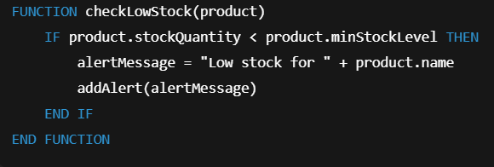
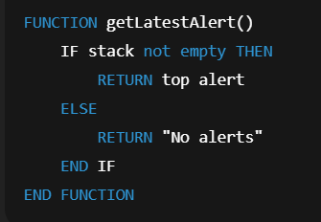
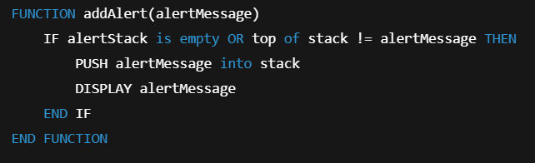
🔹 View Latest Alert
🔹 Check Low Stock
🔹 Add Alert (Avoid Duplicates)

Slide 18
MODULE 4: REPORTS & ANALYTICS
1) Introduction
Module 4 is the Reports & Analytics part of Inventra.
It converts inventory + transaction data into useful insights.
It shows the dashboard view with charts and summary counts.
Helps admins/managers monitor stock and decisions easily.
2) Purpose / Objective
To generate real-time reports from system data
To display:
Total items
Available stock
Low stock alerts
Recently issued/returned items
To support analytics like:
Frequently issued items
Monthly/weekly transaction summary
To help management take faster and correct decisions

Slide 19
MODULE 4 – KEY CLASSES
Dashboard – shows KPIs (total stock, low stock, recent logs)
Report – report object (stock/transaction/low stock)
ReportGenerator – generates reports based on type
AnalyticsService – trends (most issued, monthly summary)
ChartDataBuilder – converts data to chart format

Slide 20
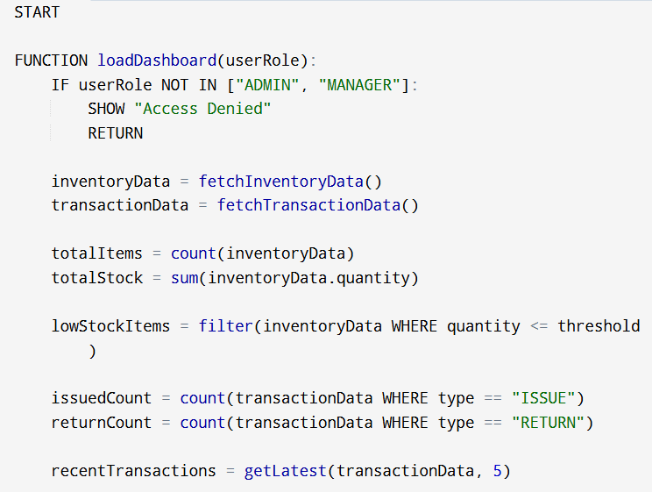
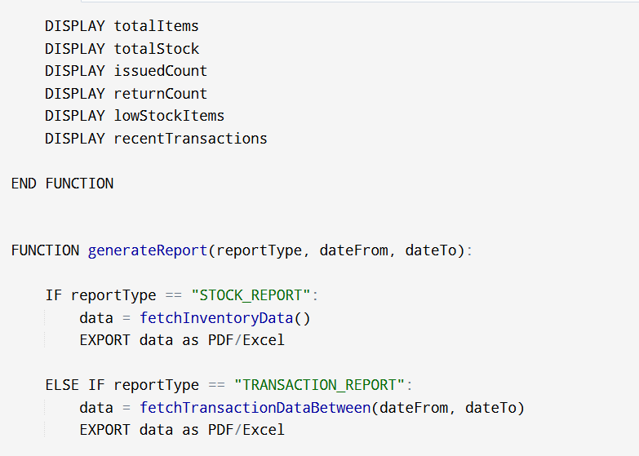
PSEUDOCODE

Slide 21
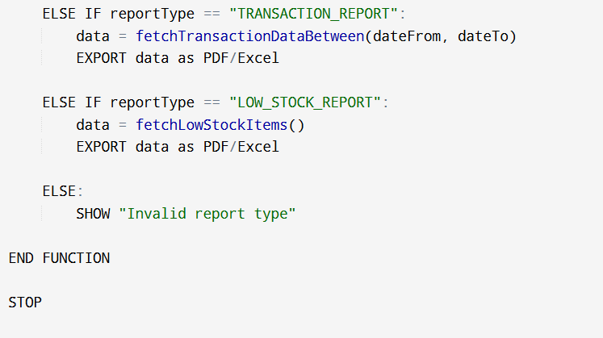

Slide 22

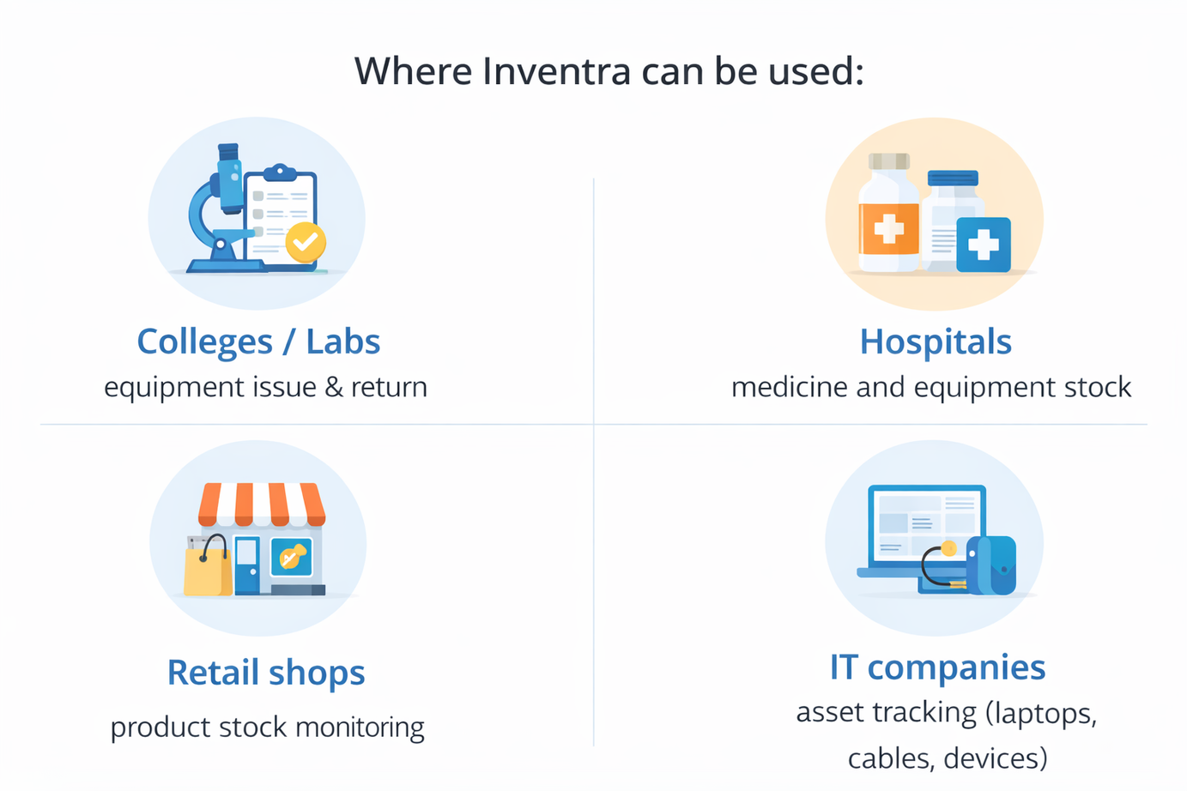
REAL-TIME / PRACTICAL EXAMPLE

Slide 23
ADVANTAGES
Saves time and reduces manual work
Provides real-time stock visibility
Ensures accountability using transaction logs
Prevents duplicate allocation of resources
Improves decision making using reports
LIMITATIONS
Needs correct data entry for accurate results
Requires proper database + backup
Role management is critical for security
System performance depends on server/network

Slide 24
CONCLUSION
Inventra helps in efficient inventory control
Provides structured modules with clear workflow
Improves tracking, security, and stock accuracy
Useful for real-world industry inventory problems

Slide 25

THANK YOU

